Slide 1
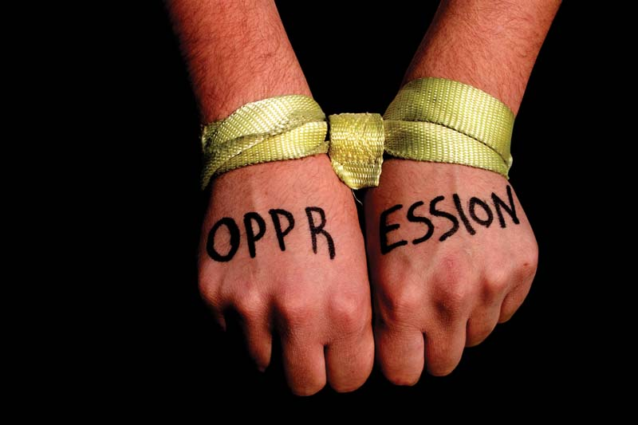
Pedagogy of the Oppressed
Chapter 3: Moving Past Oppression

Slide 2

Dialogue

Slide 3
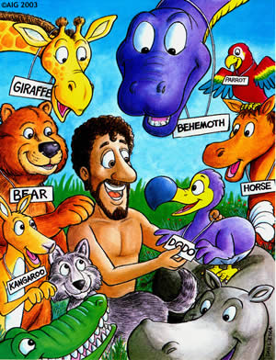
The Word

Slide 4

Naming the World Through Dialogue

Slide 5

Love

Slide 6

Humility

Slide 7

Faith

Slide 8
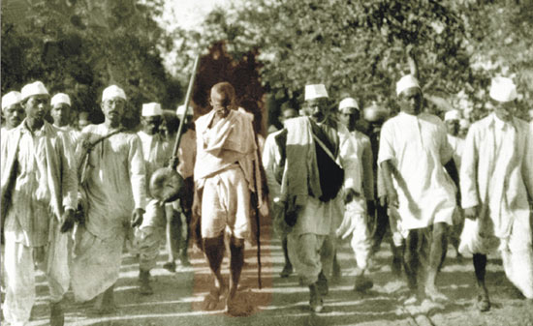
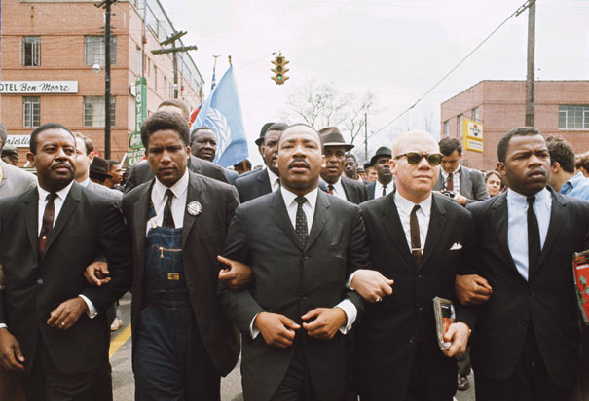
Hope

Slide 9
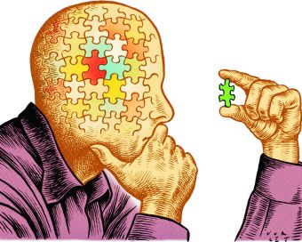
Critical Thinking

Slide 10

The Role of Educators in Dialogue

Slide 11

The Thematic Universe

Slide 12
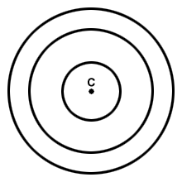
Generative Themes
“Generative themes can be located in concentric circles moving from the general to the particular” (103).
Concentric circles are circles that have the same center.

Slide 13
Freirian Concentric Circles
Themes of universal character: domination and liberation
Work inwards from the general to the particular
Repetitive Themes:
Underdevelopment and development
Found in all societies
Global Issues/themes
Specific Themes:
Ie/ Free healthcare
Themes found in many societies
Over time and through many different epoch
Specific to each nation, province, region, city, culture,
Reminds us of the importance of recognizing that even the most local, remote, or specific form of oppression/themes are rooted in larger historical sequences and universal structures of imbalance and domination (see p104)

Slide 14
Humans vs Animals
Humans
Animals
Have agency
Conscious beings
Control
Language
Aware of their activity
Create culture and history
Aware of themselves as separate from the world/reality
We create our own reality and then are confined by it
Ability to think critically
Have faith and hope
Ability to have self reflection
Act in instinct
Act for stimulation
Cannot commit themselves
Cannot construct life (culture)
Do not live but exist
Do not have a “history” merely a physical space of here and now
They cannot distinguish between themselves and the world
Cannot create products detached from themselves

Slide 15
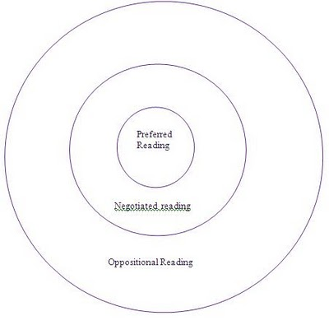
The Dialectic of a Thematic Universe

Slide 16
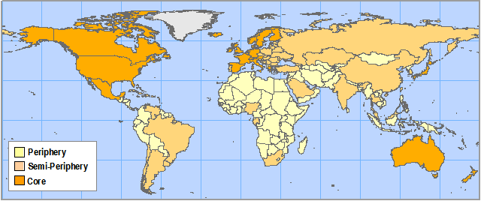
Themes at Work

Slide 17
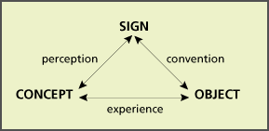
Coding
The semiotic triangle

Slide 18
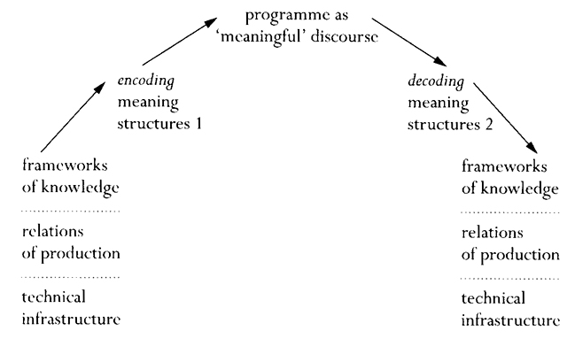
Stuart Hall

Slide 19

Investigation

Slide 20
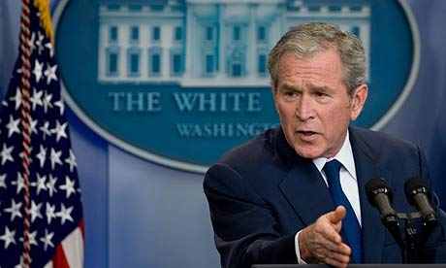
Dangers of Investigation

Slide 21

A Multi-Stage Model of Praxis

Slide 22
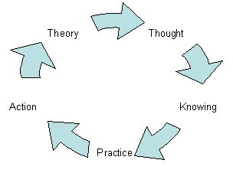
Praxis

