Slide 1
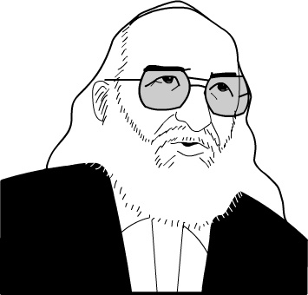
Pedagogy of the Oppressed
Chapter 4: Are We There Yet?

Slide 2
Theory of Revolutionary Action vs Theory of Oppressive Action

Slide 3
Antidialogical Action vs Dialogical Action

Slide 4
Conquest
P 139

Slide 5
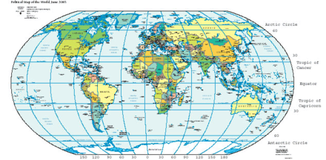
Divide and Rule
P 144

Slide 6
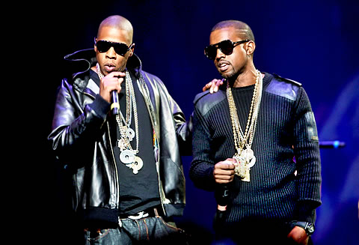
Manipulation
P 149

Slide 7
Cultural Invasion
P 153

Slide 8
Co-operation
P 168

Slide 9
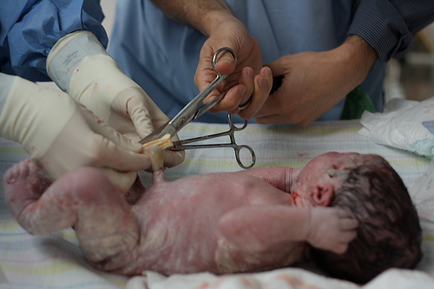
Unity for Liberation
P 172

Slide 10
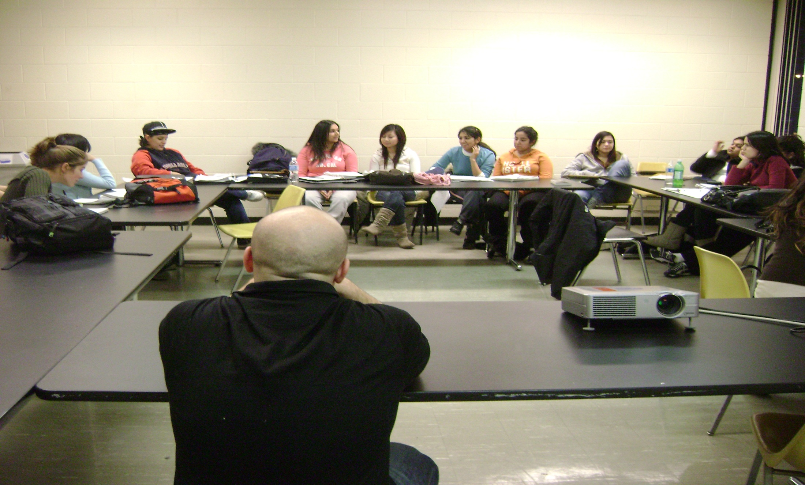
Organization
P 177/8

Slide 11
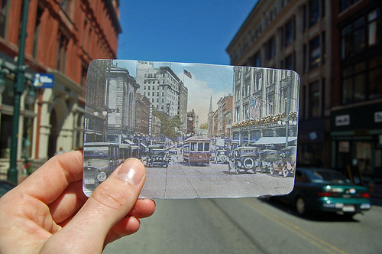
Cultural Synthesis
P 181

Slide 12
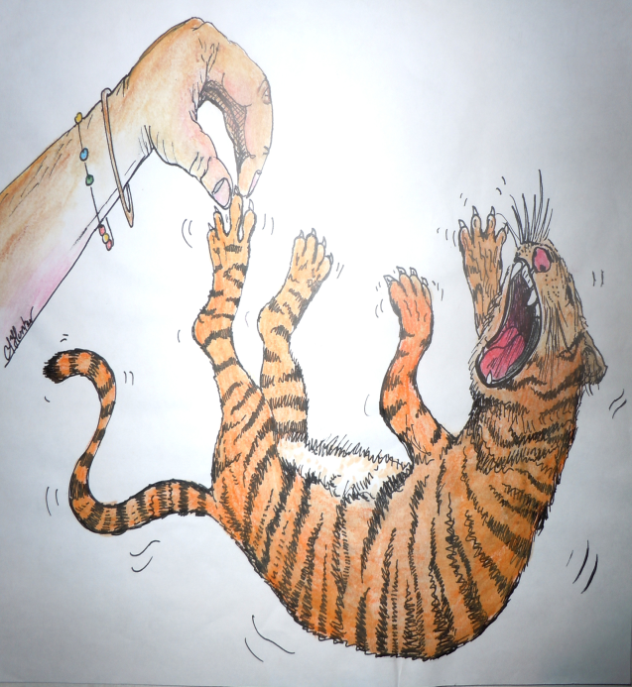
Concluding Thoughts

Slide 13
Praxis

